Slide 1
Introduction to Statistical Learning
Tianhang Zheng
https://tianzheng4.github.io

Slide 2
Course Website
https://tianzheng4.github.io/umkc-teaching/2023-fall-teaching-1/
What are on the course website:
Lecture slides
Lab material
Contact Information
If you are interested in my research, feel free to contact me.

Slide 3
Notations (Supervised Learning)
Vector/Matrix/Tensor predictor X (also called inputs, regressors, covariates, features, independent variables)
Outcome Y (also called dependent variable, response, target)
Objectives:
Accurately predict the outcomes of unseen test cases
Understand which inputs affect the outcome, and how
Assess the quality of our predictions and inferences

Slide 4
Notations (Supervised Learning)
Task: Predict the income based on years of education, years of work, etc.
Outcome Y is Income
Predictors are years of education, years of work, etc. (Denoted by X)
Modeling: $Y=f\left(X\right)+ε$

Slide 5
How to assess a model
Prediction Error (regression problems)
Prediction Accuracy (classification problems)
Model Variance
Interpretability

Slide 6

Prediction Error
Given a training dataset $D$, and a prediction function learned on $D$ (i.e., $g(X;D)$), the prediction error on $X$ can be defined as
$$E_{D}[ {\left(Y −g\left(X;D\right)\right)}^{2}]$$
$f\left(X\right)=E\left(Y | X\right)$ is the function that minimizes the prediction error.
$Y=f\left(X\right)+ε$, where $ε$ is irreducible error (because minimization)

Slide 7


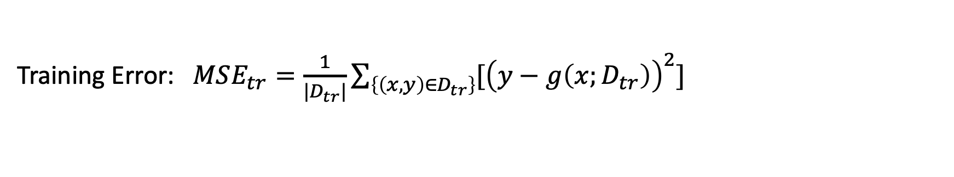
Prediction Error
Given a training dataset $D_{tr}$ and a testing dataset $D_{te}$, and a prediction function learned on $D_{tr}$ (i.e., $g(X;D_{tr})$), the prediction error can be defined as
$$E_{D}[ {\left(Y −g\left(X;D_{tr}\right)\right)}^{2}]$$
Training Error: $MSE_{tr}=\frac{1}{|D_{tr}|}\sum_{\left\{\left(x, y\right)∈D_{tr}\right\}}{[{\left(y−g\left(x;D_{tr}\right)\right)}^{2}]}$
Testing Error: $MSE_{te}=\frac{1}{|D_{te}|}\sum_{\left\{\left(x, y\right)∈D_{te}\right\}}{[{\left(y−g\left(x;D_{tr}\right)\right)}^{2}]}$

Slide 8
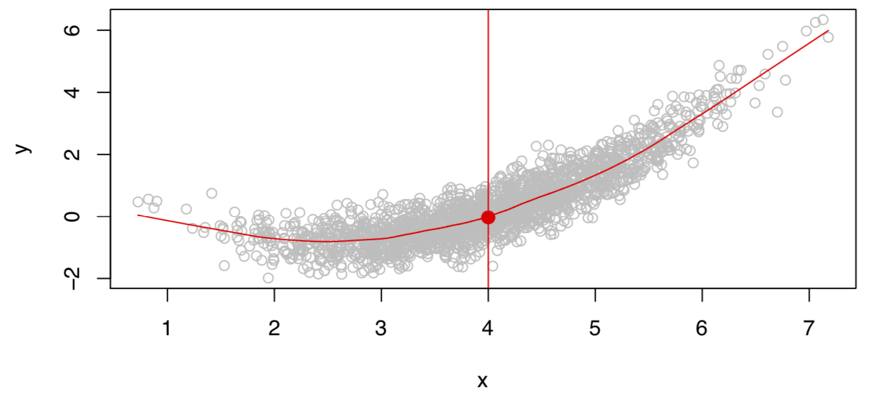
What is an ideal model?
Given X, there may be multiple outcomes Y due to different $ε$.

Slide 9
What is an ideal model?
The ideal model characterizes the expectation of the outcome.
$$f\left(X\right)=E(Y|X)$$
The ideal model here is also called the regression function.
If $X$ is a vector, $X=[X_{1}, X_{2}]$
$$f\left(x\right)=E(Y|X_{1}=x_{1}, { X}_{2}=x_{2})$$

Slide 10
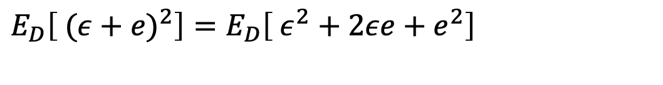


Decompose the Prediction Error
$$E_{D}\left[ {\left(Y −g\left(X\right)\right)}^{2}\right]=E_{D}\left[ {(\left(Y −f(X))+(f(X) −g\left(X;D\right)\right))}^{2}\right]$$
$$ε$$
$$e$$
$E_{D}\left[ {(ε+e)}^{2}\right]=E_{D}\left[ {ε^{2}+2εe+e}^{2}\right]$
$$E_{D}\left[ {(ε+e)}^{2}\right]=E_{D}\left[ {ε^{2}]+E_{D}[2εe]+E_{D}[e}^{2}\right]=ε^{2}+2εE_{D}\left[e\right]+E_{D}[e^{2}]$$
$E_{D}\left[ {(ε+e)}^{2}\right]=ε^{2}+E_{D}[e^{2}]$ irreducible error + reducible error

Slide 11



Decompose the Prediction Error
$$E_{D}\left[ {\left(Y −g\left(X\right)\right)}^{2}\right]=bias^{2}+variance+σ^{2}$$
Bias:
$$E_{D}\left[g\left(X;D\right)\right] −f(X)$$
Depends on
model complexity
Variance:
$${E_{D}[E}_{D}\left[g\left(X;D\right)\right] −g(X;D)]$$
Irreducible error:
$$ε or σ$$

Slide 12
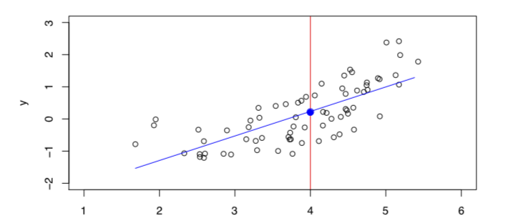
Regression Models (to Estimate g(X))
Linear Models:
$g\left(X\right)=β_{0}+β_{1}X_{1}+ …+β_{p}X_{p} (X=[X_{1},…., X_{p}]$)

Slide 13
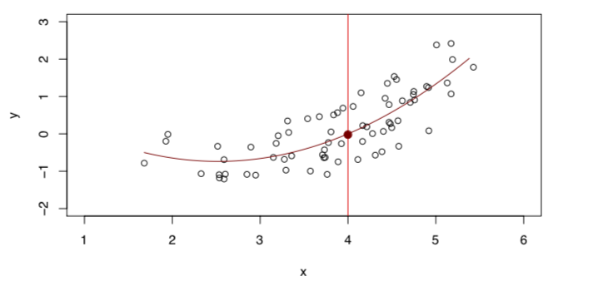
Regression Models (to Estimate g(X))
Quadratic Models:
$g\left(X\right)=β_{0}+β_{1}X_{1}+β_{2}X_{1}^{2} (X=[X_{1}]$)

Slide 14
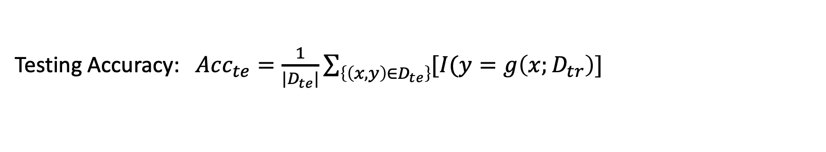
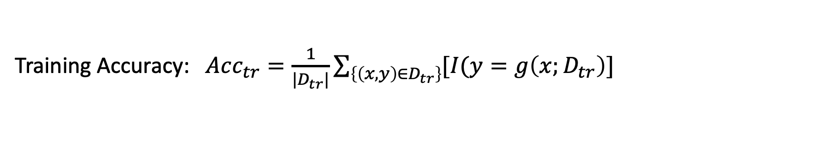
Prediction Accuracy
Given a training dataset $D_{tr}$ and a testing dataset $D_{te}$, and a prediction function learned on $D_{tr}$ (i.e., $g(X;D_{tr})$), the prediction accuracy can be defined as
$$Acc=E_{D}[I(Y=g\left(X;D_{tr}\right)]$$
Training Accuracy: $Acc_{tr}=\frac{1}{|D_{tr}|}\sum_{\left\{\left(x, y\right)∈D_{tr}\right\}}{[I(y=g\left(x;D_{tr}\right)]}$
Testing Accuracy: $Acc_{te}=\frac{1}{|D_{te}|}\sum_{\left\{\left(x, y\right)∈D_{te}\right\}}{[I(y=g\left(x;D_{tr}\right)]}$

Slide 15
Classification Models
The output of classification models are labels
Logistic Regression Models
Support Vector Machine
K-Nearest Neighbors

Slide 16

Model Bias and Variance
$$E_{D}\left[g\left(X;D\right)\right] −f(X)$$
Model Bias
Model Variance: The variance of parameters (but what is the standard?)
Better metric: ${E_{D}[E}_{D}\left[g\left(X;D\right)\right] −g(X;D)]$

Slide 17
Bias and Variance Trade-off
If a model is more complicated (e.g., with more parameters):
The bias is expected to be smaller
The variance is expected to be larger

Slide 18
Interpretability
The importance of each predictor?
Why a model makes a particular decision?
Example: Linear Model
$$Income=5×Year of work+4×Year of Edu+0.1×Height$$

Slide 19
Accuracy and Interpretability Trade-off
If a model is more complicated (e.g., with more parameters):
The accuracy may be higher (but may suffer from overfitting)
The interpretability may be worse (It is easy to interpret linear models)

Slide 20
Other Metrics (Binary Classification)
A + B: B is the prediction, and A means the correctness of the prediction
True Positive: TP
False Positive: FP
TP + FP = 1
True Negative: TN
True Negative: FN
TN + FN = 1

Slide 21
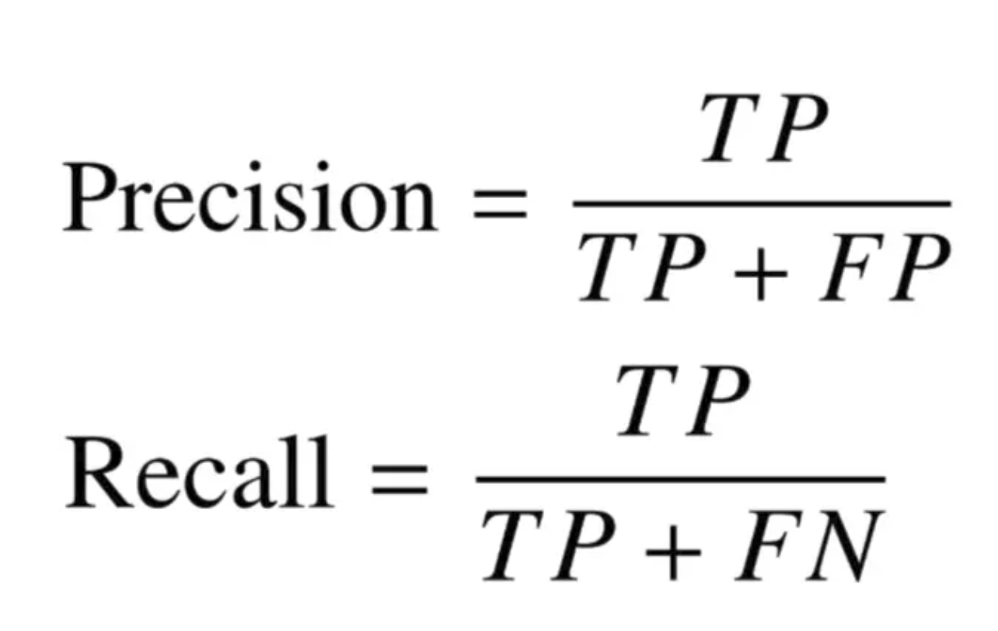
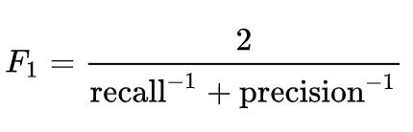
Other Metrics (Binary Classification)

Slide 22
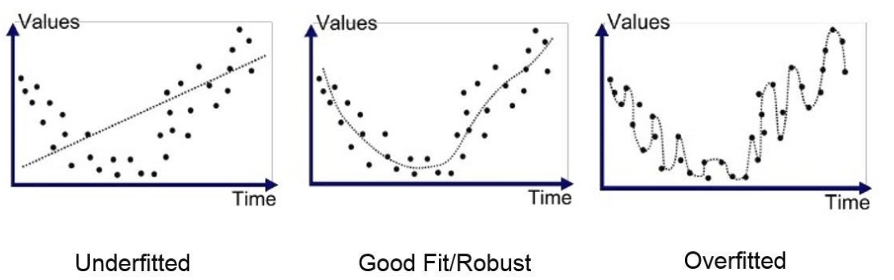
Goodfit, Underfit and Overfit
High bias
High variance

Slide 23
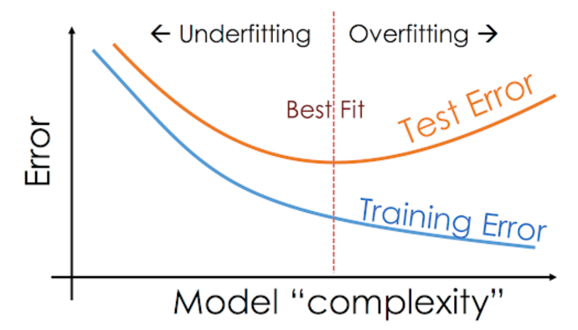
Underfit and Overfit

Slide 24
Q & A

